Slide 1
“Every waste has a potential value, if we challenge our wasteful paradigm we will find that garbage can be a resource.” - EcoCare philosophy

Slide 2
PROBLEM
1.32m tonnes per day in Brong Ahafo
1.12m tonnes collected
40:35% Organic: Solid
Notes:
In urbanised communities like the Accra, Tema, Kumasi and Takoradi.
The collection is just about only a quarter ¼ that is collected. Which I believe some 35% may go into recycling because of the sprang up of recyclers in these industrialised areas. But where do the rest go? Thrown into the odor river, major gutters and into the sea or as blockage to other water ways. Or burnt to release carbon dioxide emissions into the atmosphere. We all know the deadly repercussions of this. A) poor health, b. soil depletion, c. pressure on our landfills, d. climate change
2. In the Brong Ahafo’s that seems not highly industrialised so you wouldn’t expect it generate huge tonnes of waste as the industrialised cities and regions; well the story is almost the same. That’s about 84% collection. That sounds good. But the 100 dollar question is: What happens to this the 84 collected and the 16 left = both end up in landfills, or in gutters, rivers, or burnt. Same ways as in the urban centres. But the interesting thing about my region is: a higher percentage of organic is rather produce than plastics.
So if we could we turn our waste into resources, we would soon not be complaining of waste but be handling every waste we generate with care. This has a long term propensity to end waste reduction and especially the amount that goes into destroying our environment.

Slide 3
MSW expected to double by 2025
Globally: 1.3 – 2.2 b tonnes/year
Per capita: 1.2 to 1.42 kg/person/day
124 million tonnes per year;
average of 0.65kg/capita/day in Developing parts like Ghana
Notes:
According the World Bank,
MSW generation is expected to double by 2025;
Globally: from 1.3 billion tonnes to 2.2 billion tonnes per year;
Per capita: 1.2 to 1.42 kg per person per day
That means in developing parts of the sub-Saharan Africa, like Ghana, waste generation is expected to increase from 62 million to 124 million tonnes per year, with an average of 0.65kg/person/day.
Meaning; you and I will be generating about this size of waste everyday in the next 15 years.
We would have to pay Zoom lion and other informal waste pickers about trice as we pay now – because they would be picking our bins at least twice a week.
Unless we do something about Waste Generation…

Slide 4
Photo credits: Ghanaweb; GettyImages
Notes:
The recurring problem and consequence of plastic waste pollution is something messy like this. I hope you can appreciate it.
[add some photos on CO2, Acid rain, ]
I added food, fish and water, because we mostly don’t imagine what effect our pollution has on these; and yet these are the common things that we all share no matter where they are or come from.
So people can see Plastic Waste Menace as a collective responsibility.

Slide 5
Implications
Behaviour alteration
Climate change
Economic crunch
SO WHAT IF WE LOOKED AT THE PROBLEM AS PEOPLE ORIENTED?
WHAT IF WE STARTED LOOKING A SOLUTION MORE HUMAN CENTERED THAN WE HAVE ALREADY
Notes:
The numbers are not even the problem. These are the real problem – which is faced by you and I
The most sufferers of these consequences is usually the poor rural settler who does not contribute any much to the problem
SO WHAT IF WE STARTED LOOKING AT SOLUTION MORE HUMAN CENTRED THAN WE HAVE IN THE ALREADY?

Slide 6
SOLUTION: People-Centered
Attitude =
Advocacy + Incentive
Environment = 360 PRUP
Plastics = Recycle +
Upcycle
Goal: waste free
Communities +
Democratize recycling
Notes:
We developed this solution to pilot in rural and peri-urban communities in the Asunafo North Municipality – Brong Ahafo.
We have chosen Goaso and Mim to represent peri-urban and one village each under these two – to represent rural communities.
OUR GOAL: to create a waste free Ahafo through responsible consumption and production and democratization of recycling.

Slide 7
EcoCare Waste Initiative

Slide 8
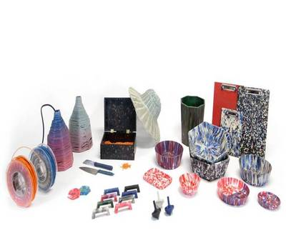
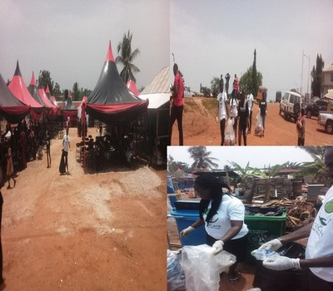
PRODUCT DEMO
Advocacy
Recycling
People
DIY
EcoEvent
Technology
Notes:
Start from Advocacy + DIY + EcoEvent
Show their two pics on right
Developing technologies + Recycling models = democratize recycling and make it attractive and easy for every household to be interested and support
Show two pics on left

Slide 9
BUSINESS MODEL
EcoEvent CleanUp Service
Collection and Sale of Plastic wastes and Cartons to recyclers
Notes:
1. Partnership inclusive models – Trashybags/Zaacoal = partnered on the use strategies; COLIBA = on the distribution and collection channels – by subscribing to their app

Slide 10
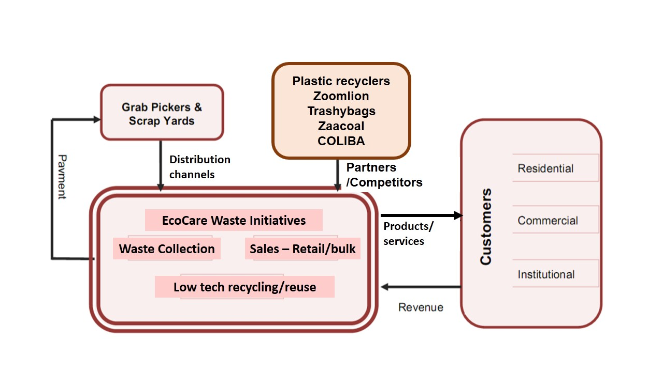
BUSINESS MODEL
Notes:
Summarizes our Business Model and Distribution Channels
Partnership inclusive models – AMEND, SarfoLiz Engineering & Construction Works
Revenue from -

Slide 11
Financial Projections
Budget for 6 Months Pilot
Item Name | Unit Cost | # of Units | Total Cost
Waste bins | 45 | 10 | 450
Protective Gloves | 15 | 10 | 150
Over-alls | 40 | 10 | 400
Protective boots | 25 | 10 | 250
Transportation | 30 | 12 | 360
Waste pickers and sorters allowances | 75 | 5 | 375
Rent of Storage site/warehouse | 40 | 6 | 240
Education/Promotion | 150 | 6 | 900
TOTAL |  |  | 3125
Notes:
1. Partnership inclusive models – Trashybags/Zaacoal = partnered on the use strategies; COLIBA = on the distribution and collection channels – by subscribing to their app

Slide 12
Financial Projections
Notes:
1. Partnership inclusive models – Trashybags/Zaacoal = partnered on the use strategies; COLIBA = on the distribution and collection channels – by subscribing to their app

Slide 13
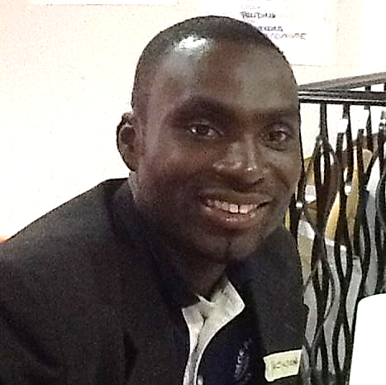
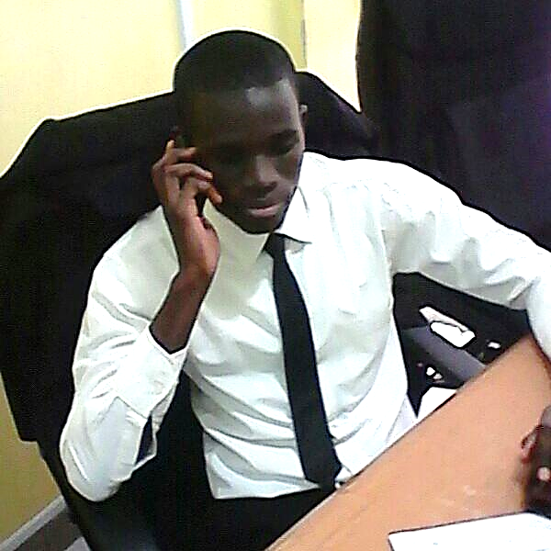
The EcoCare Team
FELIX AMPONSAH
Environmental Engineers,
Product Designing
JACKSON NYARKO
President,
Conservation, Entomology
FRANK YEBOAH
Finance Director,
Banking & Finance
ACHEAMPONMAA DUFFOUR
Communications
Hnd
Notes:
We are tem of 7 = 4 men + 3 women. Highly gender inclusive ☺
And these are the 5 core team members. Patience is supported by Nana Akua; and Frank is supported by Isaac

Slide 14
EcoCare!!!
“Don’t Waste Your Waste”
“Live a Zero Waste Life”

